Slide 1
DDL Commands in SQL
Divakar P

Slide 2

What is SQL?....
SQL stands for Structured Query Language
Used to manage and manipulate relational databases
Includes commands for data retrieval, insertion, updating, deletion, and structure definition

Slide 3
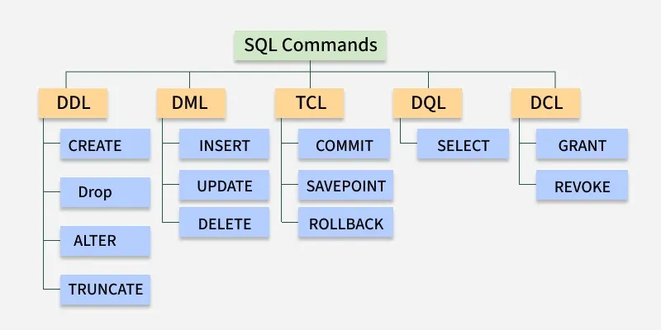
Types of SQL Commands.

Slide 4
Data Definition Language - Commands
CREATE
ALTER
The CREATE command is used to create database objects such as tables, indexes, or views.
The ALTER command is used to modify an existing database object, such as a table.
DROP
TRUNCATE
The DROP command is used to delete database objects permanently.
The TRUNCATE command removes all records from a table but keeps the structure intact.

Slide 5
Diff B/W DROP and TRUNCATE
DROP
Truncate
Completely removes the table structure and its data from the database.
Syntax : DROP TABLE table_name;
Cannot be rolled back (usually permanent).
Table no longer exists
Removes all rows (data) from the table but keeps the table structure.
Syntax : TRUNCATE TABLE table_name;
Usually cannot be rolled back (depends on DBMS, e.g SQL Server & PostgreSQL).
Table still exists, just empty

Slide 6
Commands
Rename
Comment
Used to change the name of a database object (like a table)
syntax
RENAME TABLE old_table_name TO new_table_name;
Add an explanation to the SQL code for other team members to review.
syntax
COMMENT ON TABLE table_name IS 'comment';

Slide 7
Examples

Slide 8
Conclusion…
DDL (Data Definition Language) commands are essential for structuring and managing relational databases.
Mastering these commands helps you design, maintain, and evolve your database efficiently
With DDL, you gain control over how data is organized, accessed, and secured.

Slide 9
Thank you!

